Slide 1
MARPA AGM: Network Rail Update
Marian Craig, Public Affairs Manager – Anglia route

Slide 2
Outline
Ely Area Capacity Enhancement (EACE)
Cambridge South
Cambridge re-signalling project
Haughley Junction
Wisbech – March
Soham station
Other upcoming work and closures

Slide 3
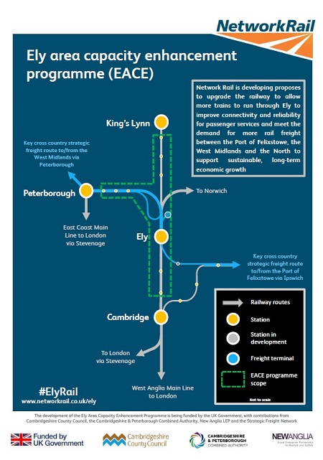
Ely Area Capacity Enhancement (EACE)
Consultation open NOW: 18 October – 28 November 2021
Meet the project team at Queen Adelaide Village Hall: 2 & 4 November and 9 & 11 November
All materials online
Please complete our survey!
www.networkrail.co.uk/Ely

Slide 4
Ely Area Capacity Enhancement (EACE)
Proposals to remodel the track layout at Ely North junction
Options for level crossings at Queen Adelaide, Stonea, Burgess Drove (Waterbeach) and Wells Engine foot crossing.
Proposals to upgrade another 15 level crossings across the wider area
Increasing capacity through Ely - additional freight trains travelling as far as the Midlands, North and Scotland

Slide 5
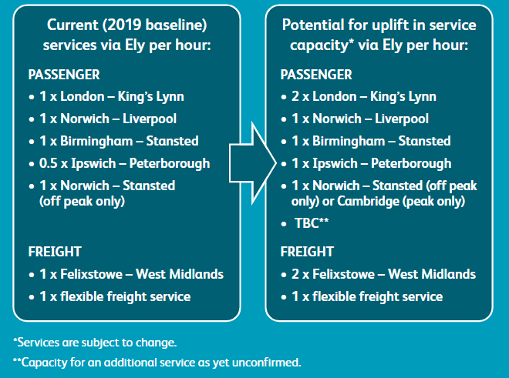
Ely Area Capacity Enhancement (EACE)

Slide 6
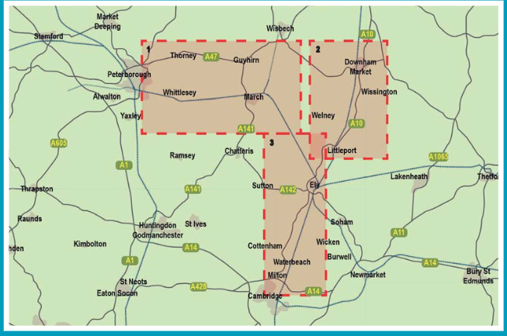
Ely Area Capacity Enhancement (EACE)

Slide 7
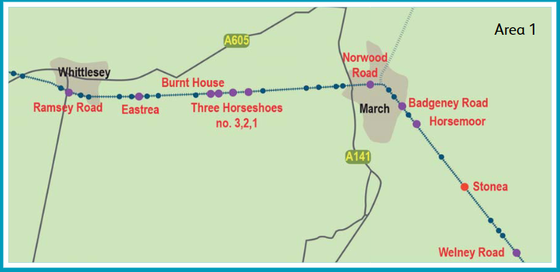
Ely Area Capacity Enhancement (EACE)
Level crossing locations (Area 1)

Slide 8
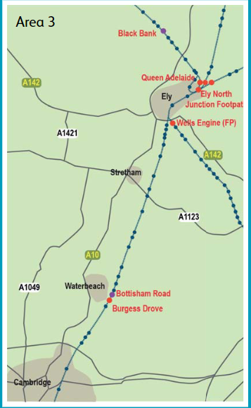
Ely Area Capacity Enhancement (EACE)
Level crossing locations (Area 3)

Slide 9
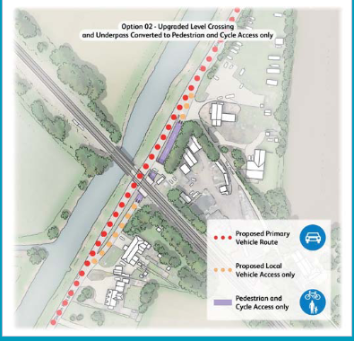
Ely Area Capacity Enhancement (EACE)
Stonea Option 1:
Upgrade to full barrier
Stonea Option 2:
Upgrade to full barrier; underpass
for pedestrians and cyclists only

Slide 10
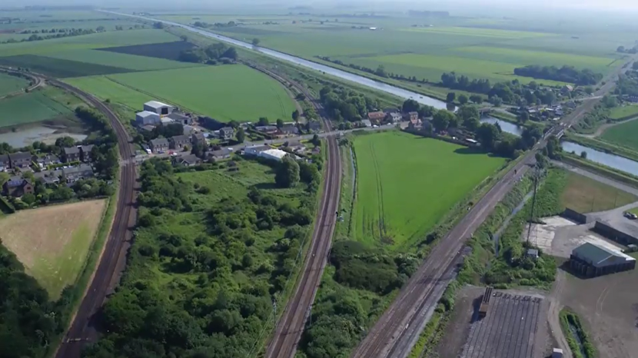
Ely Area Capacity Enhancement (EACE)
Queen Adelaide level crossings: 4 options
South east highway
Northern bypass
Long southern bypass
Short southern bypass
Range of interventions with each option including upgrading to full barriers, closing a level crossing, and compulsory purchase of land.
Notes:
Options 2,3 & 4 involve closing a LX.

Slide 11


Ely Area Capacity Enhancement (EACE)
18 – 30 October 2021 | Opening Times
Live webchat: www.networkrail.co.uk/Ely | Tuesdays, Thursdays and Fridays: 1000 -1500
 | Wednesdays: 1400 - 2000
Dedicated phone line: 0800 160 1780 | Tuesdays, Thursdays and Fridays: 1400 – 1700
 | Wednesdays: 1700 - 2000
 | Saturdays: 1000 - 1300
Email: ElyAreaCapacityEnhancements@networkrail.co.uk
Tweet: @NetworkRailANG or #ElyRail

Slide 12
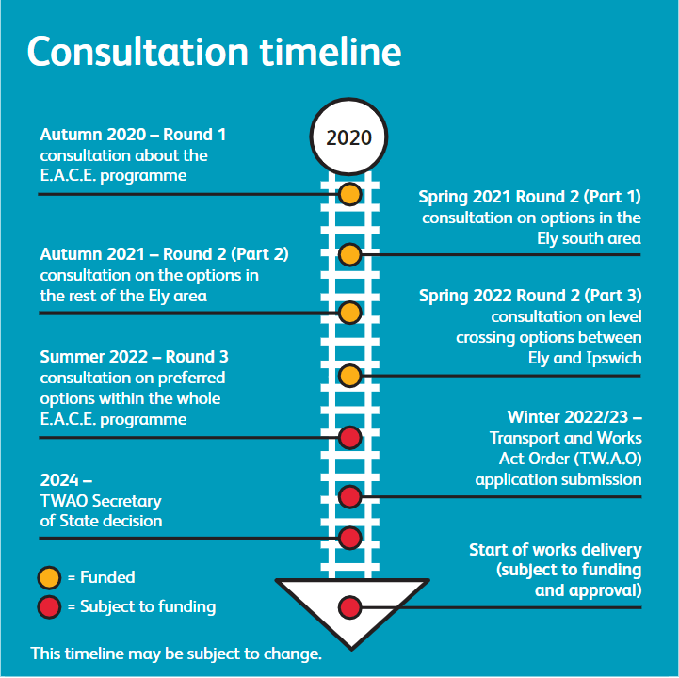
Ely Area Capacity Enhancement (EACE)

Slide 13
Cambridge South
New 4 platform station to serve biomedical campus & Addenbrooke’s Hospital
Services to London Liverpool Street and King’s Cross (WAML & ECML)
Designed station based on anticipated demand for 2043
TWAO submitted to the DfT (June 2021)
Expected completion: 2024-2025

Slide 14
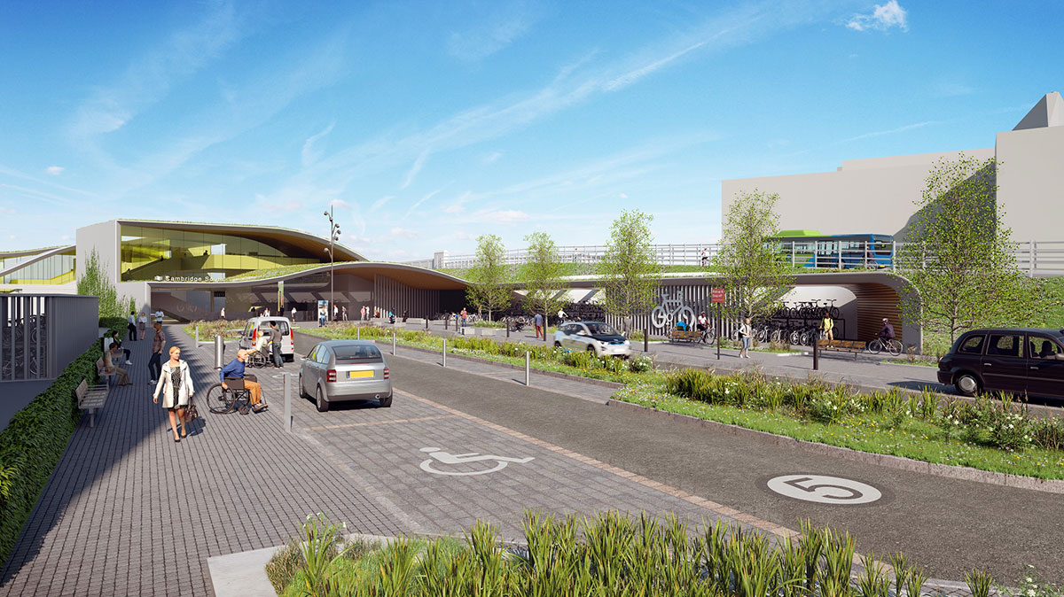
Image is for illustrative purposes only

Slide 15
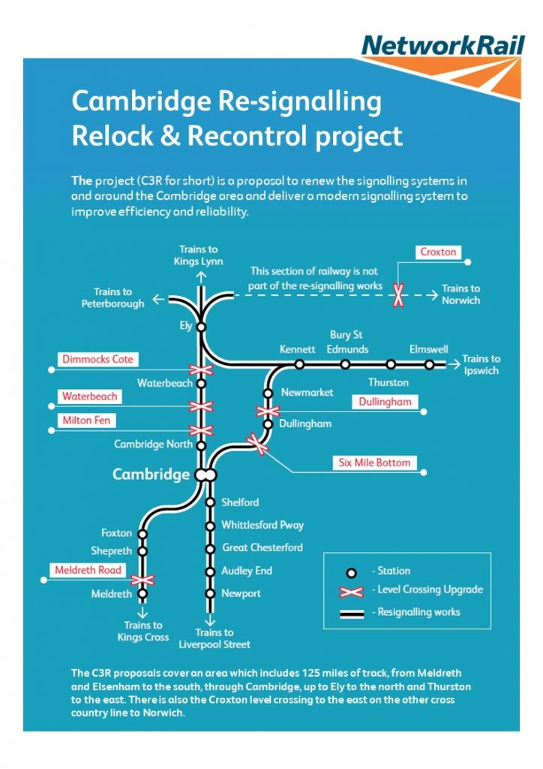
Cambridge re-signalling
Upgrading signalling control at Cambridge
New digital system – ETCS ready
Closing 3 signal boxes – control moves to Cambridge
Upgrading 7 level crossings to full barrier
Outline design contract awarded to Alstom
Expected completion 2024

Slide 16
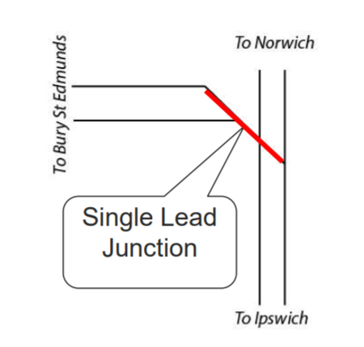
Haughley Junction
Doubling the track will allow more services to run (from EACE) without affecting performance elsewhere
Secretary of State approval – July 2020
Need green light from DfT and Treasury

Slide 17
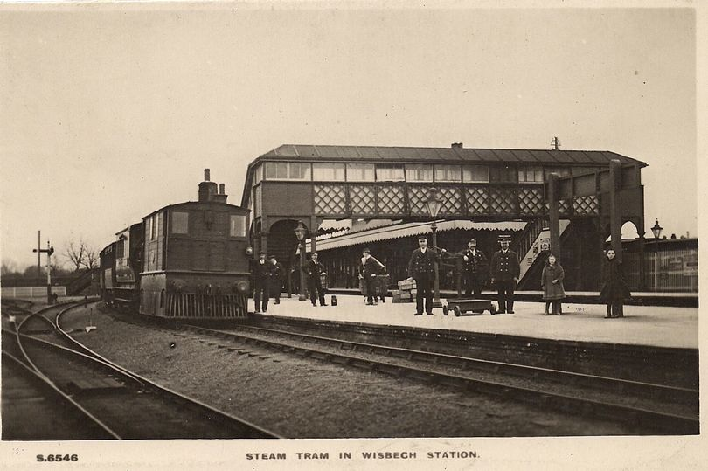
Wisbech - March
Supporting CPCA to bring the scheme forward
Tram/train or light rail an option
Steering group set up

Slide 18
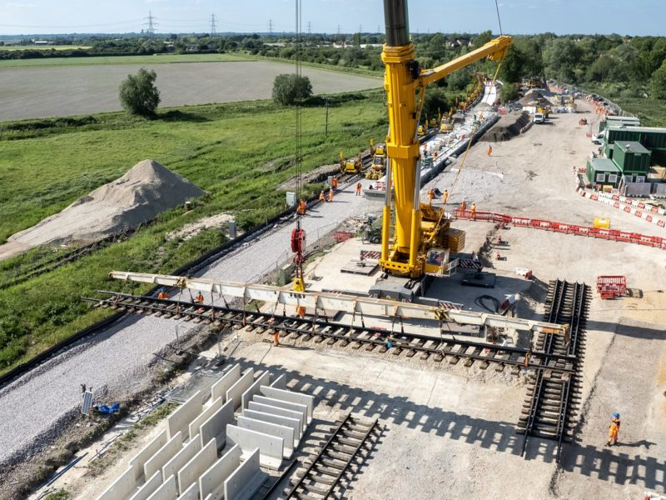
Soham
On track to open on 13 December
Will be served by 0.5tph Ipswich – Peterborough service
Scope to add further platform and track in future if required

Slide 19
Upcoming work and closures
Ipswich-Ely line: Weekend closures from 13 November until Christmas: track replacement work – check journey planners
11-12 December: Line closed Cambridge - Cambridge North. Replacement buses in operation and reduced services to London – check journey planners.
25-26 December: Manea –Elmswell/Meldreth/Audley End via Ely and Cambridge closed for Cambridge re-signalling prep work

Slide 20
Questions?
Marian Craig, Public Affairs Manager – Anglia route
Marian.craig@networkrail.co.uk

